Slide 1
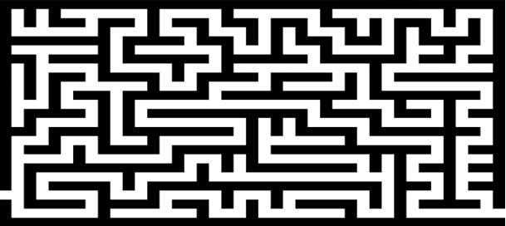
MAZE GAME Team Details: Chaitanya Shaligram 16010120104 Ankur Shetty 16010120106

Slide 2
PROBLEM STATEMENT: To Design a simple 2d maze using pygame module wherein the player using the arrow keys has to move around the maze and reach the endpoint with less number of steps.
What is maze?
A maze is a puzzle with twists and turns, where you try to find a path from the entrance to the exit without hitting dead ends.

Slide 3
SYSTEM ARCHITECTURE:
Start
Window appears
Maze 1
Maze 2
Popping up sound and game starts
Find shortest route towards banana
Winning window pops up
Main Menu
Game Quit
Enter
Esc

Slide 4
FEATURES OF DESIGNED SYSTEM
Main game window having options to choose between two levels.
Sound effect when the game starts and when the game ends.
Title and icon of the game .
Collision detection.
Keyboard controls for movement of the monkey in all four directions.
Winning window pops up when the monkey reaches banana.

Slide 5
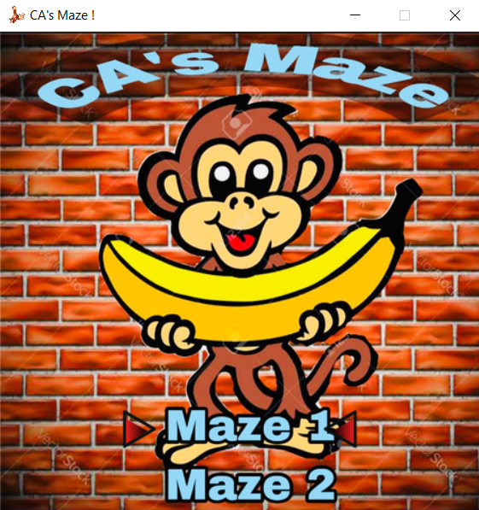
RESULT

Slide 6
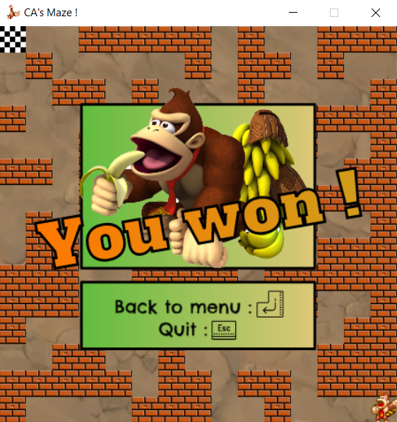
RESULT:

Slide 7
CONCLUSION: In this project we learnt how to make a basic two-dimensional maze using the pygame library in Python. We leant how to use different event loops for the movement of the player around the maze. We learnt how to add images and sound effects. The maze is playable and fully functional in which we added two levels to make the game more interesting.

Slide 8
References :-
https://www.pygame.org/docs/
https://itch.io/game-assets/free/tag-2d
https://www.youtube.com/watch?v=FfWpgLFMI7w&t=639s
https://pythonguides.com/python-pygame-tutorial/
THANK YOU

